Slide 1



Implementation of PSI XML standards at the SIB and at GeneBio
Aldente and Phenyx
Pierre-Alain Binz
PSI breakout workshop
HUPO 2004, Beijing
23.10.2004

Slide 2
Aldente
Aldente is a protein identification tool for PMF data
Developed in the PIG at the SIB
It will replace PeptIdent, that will get retired
Incorporates the Hough transform to realign peptide hits, recalibrate spectra and exclude outliers
Scoring is configurable
It considers annotation as described in Swiss-Prot (splicing variants, chains, PTMs, etc)
Is accessible over a web interface. Java application has been also developed for internal use
Runs on the ExPASy server at www.expasy.org/tools/

Slide 3
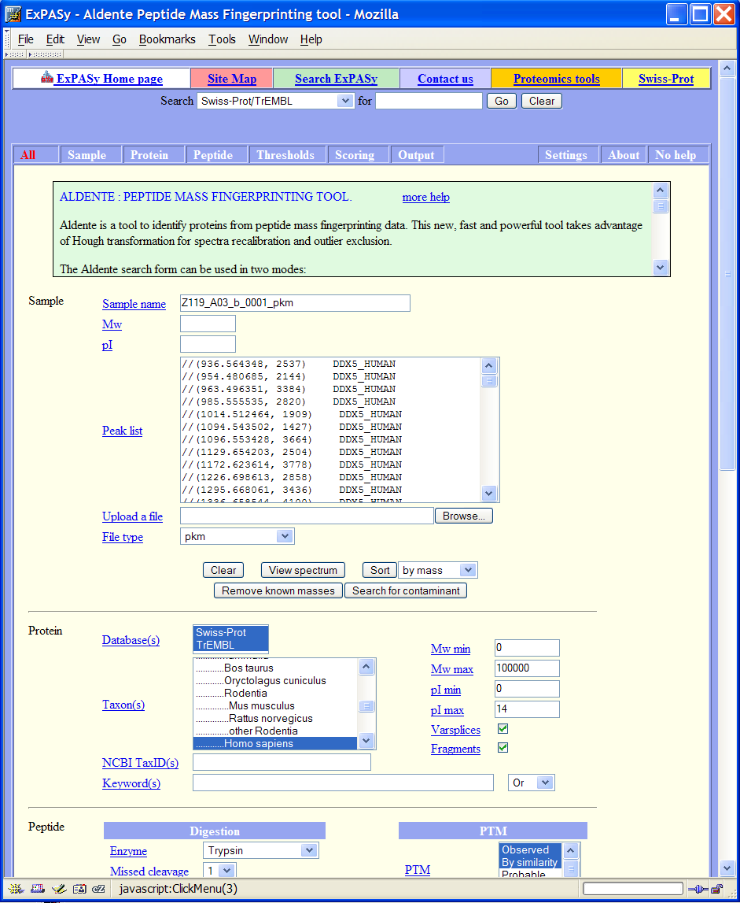
Import of mzData files, export of mzIdent
mzData will be supported as soon as the release is out
Peaklist (mzData) viewer modified from the tool presented last year at HUPO2003

Slide 4

www.phenyx-ms.com
Phenyx is a software platform dedicated to identification and characterization of proteins and peptides from mass spectrometry data
Client-server application developed by GeneBio, in collaboration with the SIB
The core calculation engine
  Incorporates the true probabilistic and flexible scoring system OLAV, developed at GeneProt
  Includes the core of Aldente for its PMF functionalities
  Public Core calculation engine hosted by Vital-IT (registration required). Local installations available
The Phenyx Virtual Desktop
  Java Application (freely available) to manage user-profiles, job submissions, and results evaluations
  Lots of functionalities: Batch submission; private scorings, DBs, AA modif. and enzyme cleavages; job comparison; statistics for QC; exports to excel; dynamic and graphical evaluation of results; high-throughput capable;…
Integration into experimental workflows and interaction with LIMS proven
Poster on Wednesday

Slide 5
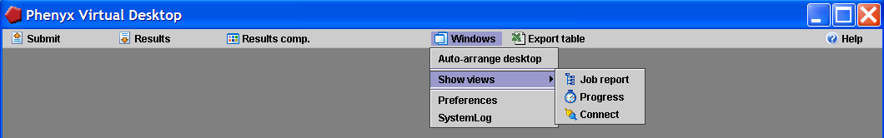
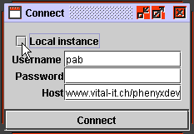
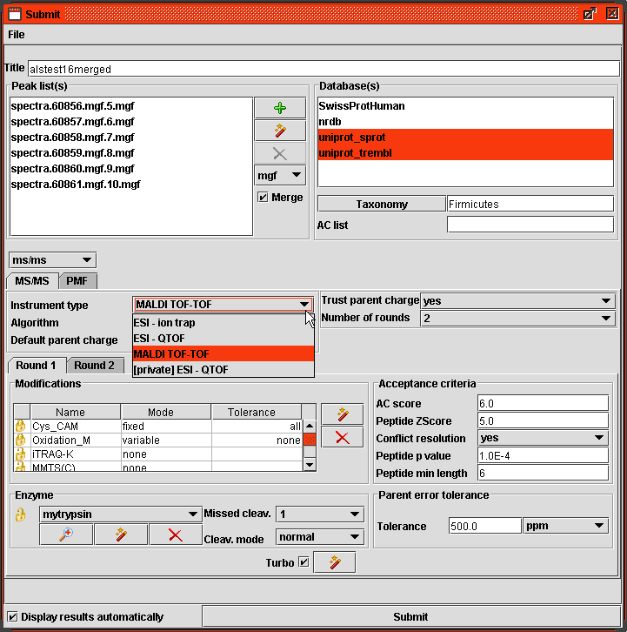
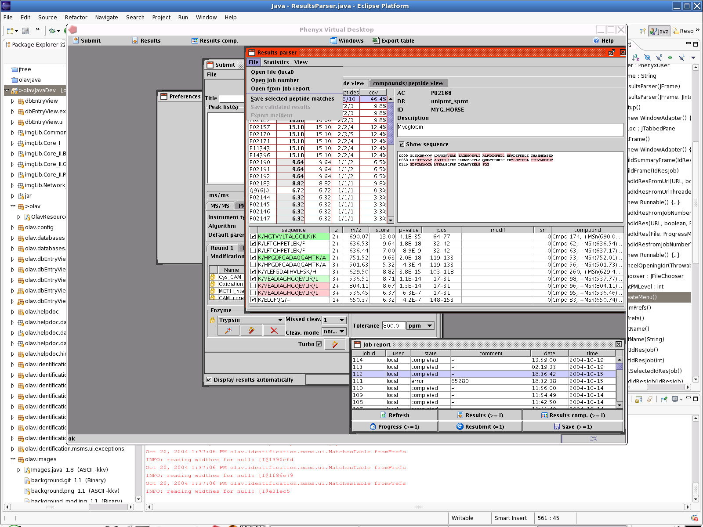
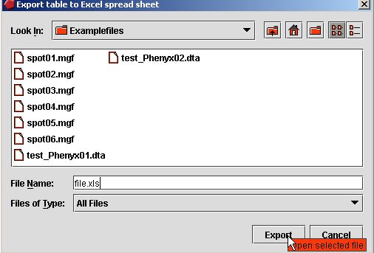
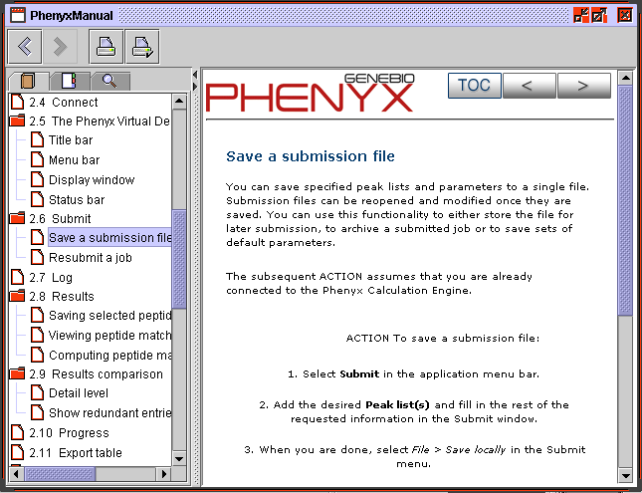
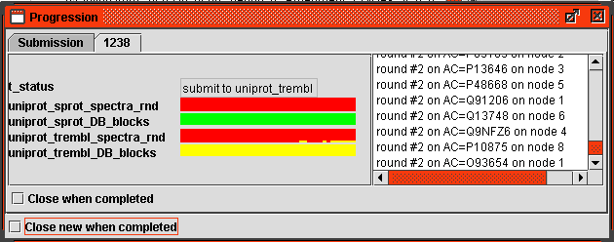
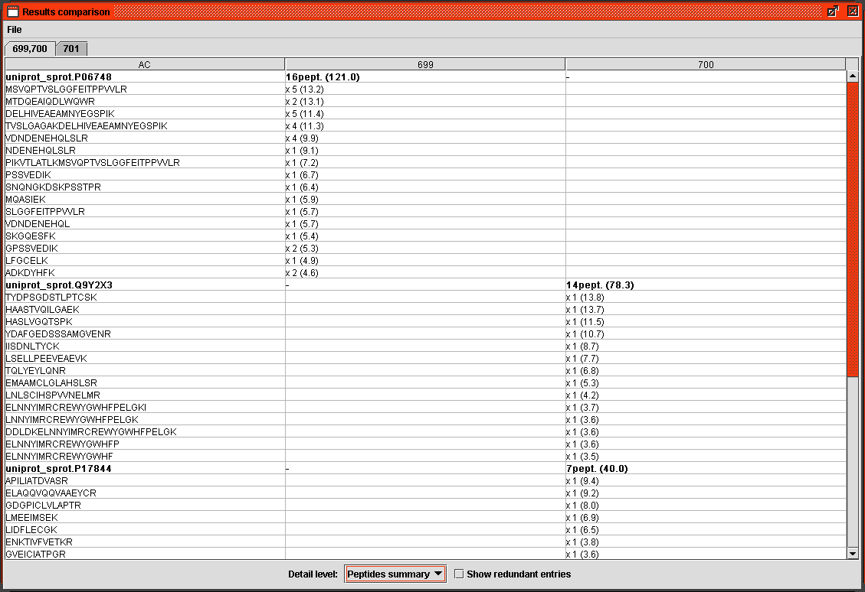
Phenyx typical workflow
Connect
Submit
Job report
Results
Start PVD and
connect to PCE
Prepare, store and
send submission,
Access to user profiles
View status of
jobs, Select jobs to
evaluate and store,
Resubmit jobs
Open and evaluate
results, View statistics,
store results locally
Export
table
Export tables from the PVD
into excel spreadsheets
Help
Progress
Results
comp.
View online manual
Access contextual help
View release notes
Progression window,
View status of all PVD
and PCE actions
Compare different results
in one table
Quickly view one or
more results

Slide 6
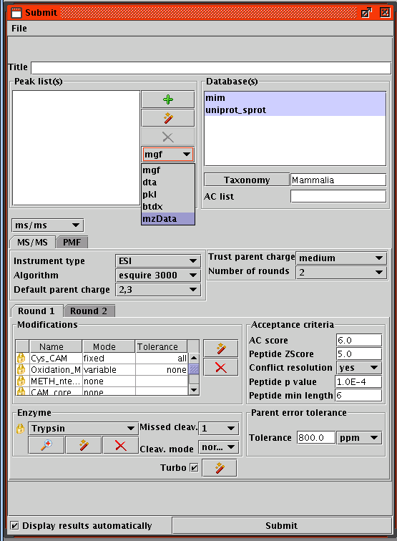
Import of mzData files
mzData is supported as input files in a beta version
Will be available as soon as the mzData release is out
Peaklist (mzData) viewer modified from the tool presented last year at HUPO2003

Slide 7
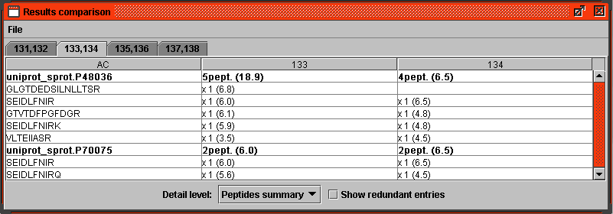
Export to mzIdent files, read mzIdent files

